Slide 1
DATA WRANGLING
DATA COLLECTION AND DATA PROCESSING

Slide 2
LEARNING OBJECTIVES
Become familiar with the tidy data format
Increase familiarity of data wrangling functions
Identify R packages that facilitate data processing

Slide 3
DATA WRANGLING
A fair amount of time (up to 80%, perhaps) must be spent on data processing (both cleaning and manipulation).
The main goals of data wrangling are to:
make the data useable by a specific piece of software
reveal pre-analysis insights in the data

Slide 4
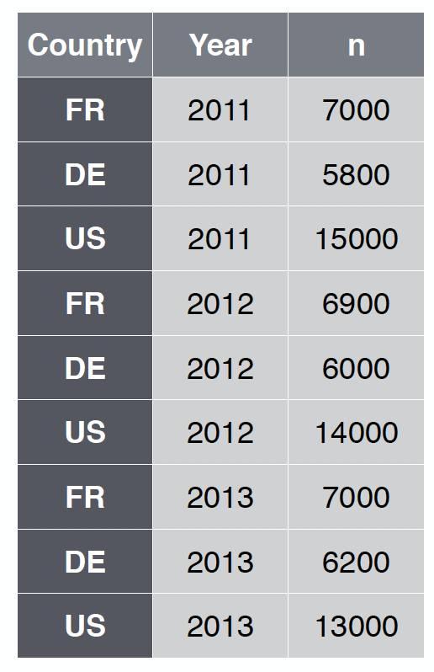
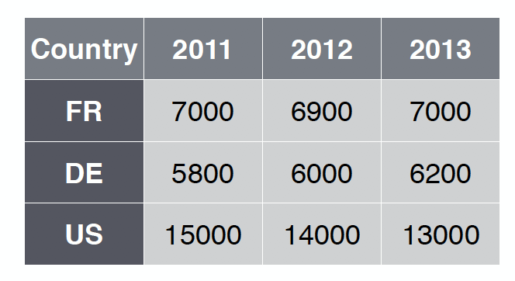
TIDY DATA
Tidy data has a specific structure:
each variable is a column
each observation is a row
each type of observational unit is a table
vs.

Slide 5
Functionality
Data wrangling functions should allow the analyst to:
extract a subset of variables from the data frame
extract a subset of observations from the data frame
sort the data frame along any combination of variables in increasing or decreasing order
to create new variables from existing variables
to create (so-called) pivot tables, by observation groups
database functionality (joins, etc.)
etc.

Slide 6
Functionality
In R, this can be achieved in various ways. Current favoured packages include:
tidyr
dplyr (data transformation)
lubridate (dates and times)
stringr (string manipulation)
purrr (functions)
readr (data import)
For equivalent Python modules, consult Kazil & Jarmul’s Data Wrangling with Python.

Slide 7
EXERCISES
What would the following dataset look like in a tidy format?
storm | stat | value
Alex | wind | 68
Alex | pressure | 130
Allison | wind | 55
Allison | pressure | 121
Bobbie | wind | 72
Bobbie | pressure | 118

Slide 8
EXERCISES
How would you go from the table on the left to the table on the right?
storm | stat | value
Alex | wind | 68
Alex | pressure | 130
Allison | wind | 55
Allison | pressure | 121
Bobbie | wind | 72
Bobbie | pressure | 118
stat | mean | std dev
wind | 65 | 8.9
pressure | 123 | 6.2

Slide 9
EXERCISES
Run section 9 of the notebook CSPS 04 R Basics.ipynb to explore how the packages tidyr and dplyr help the process of data wrangling in R.

Slide 10
EXERCISES
Turn the data found in cities.txt into a tidy dataset.

